Slide 1
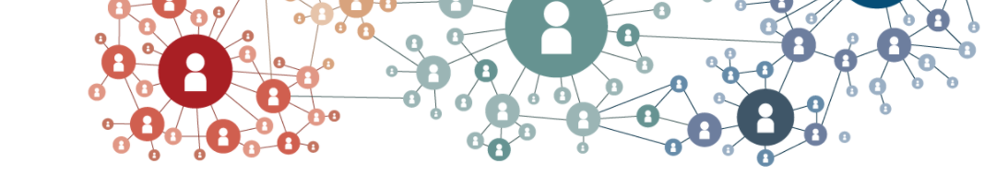
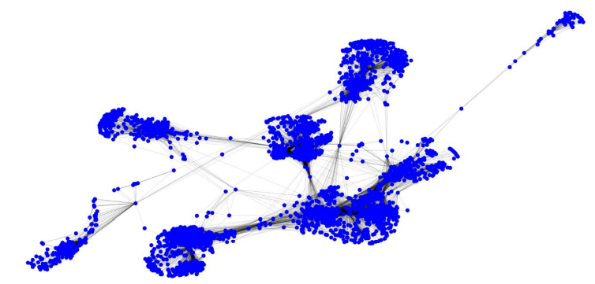
Social Network Analysis
By
Amir Ali

Slide 2
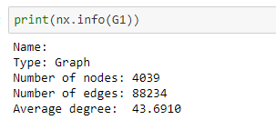
SNAP Dataset
Social Circles : Facebook
Source: SNAP: Network datasets: Social circles (stanford.edu)

Slide 3
Methods for Analysis
Find centrality in graphs
1.1 Degree Centrality
1.2 Betweenness Centrality
1.3 Closeness Centrality
1.4 Eigenvector Centrality
Find the Shortest Path
Find All Neighbors Nodes
Count Degree Nodes

Slide 4
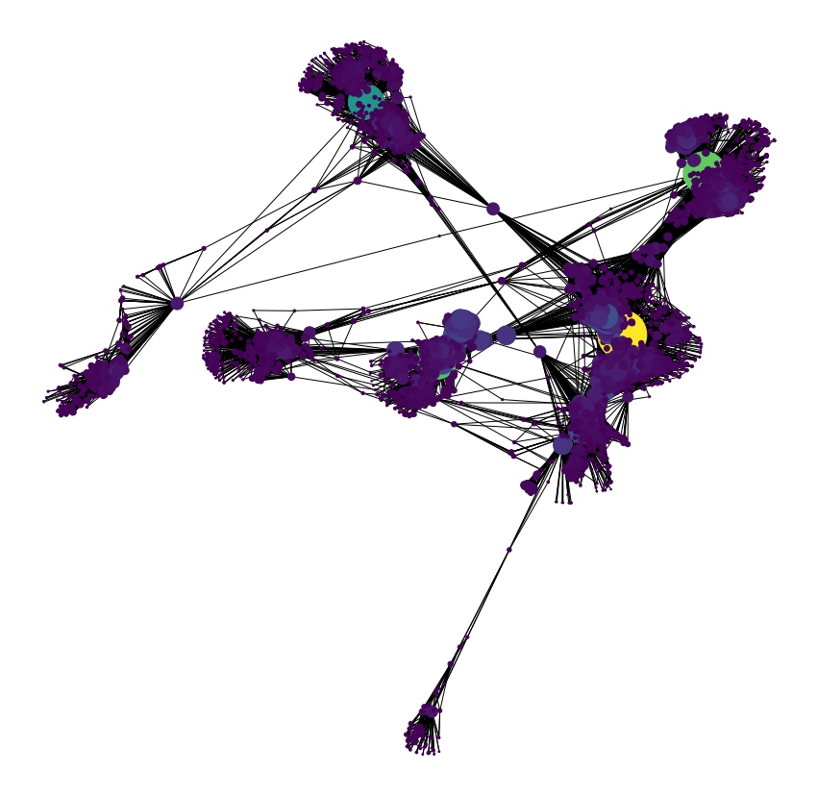

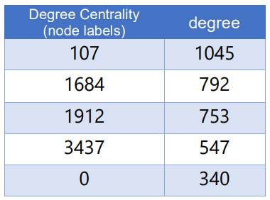
Degree Centrality

Slide 5

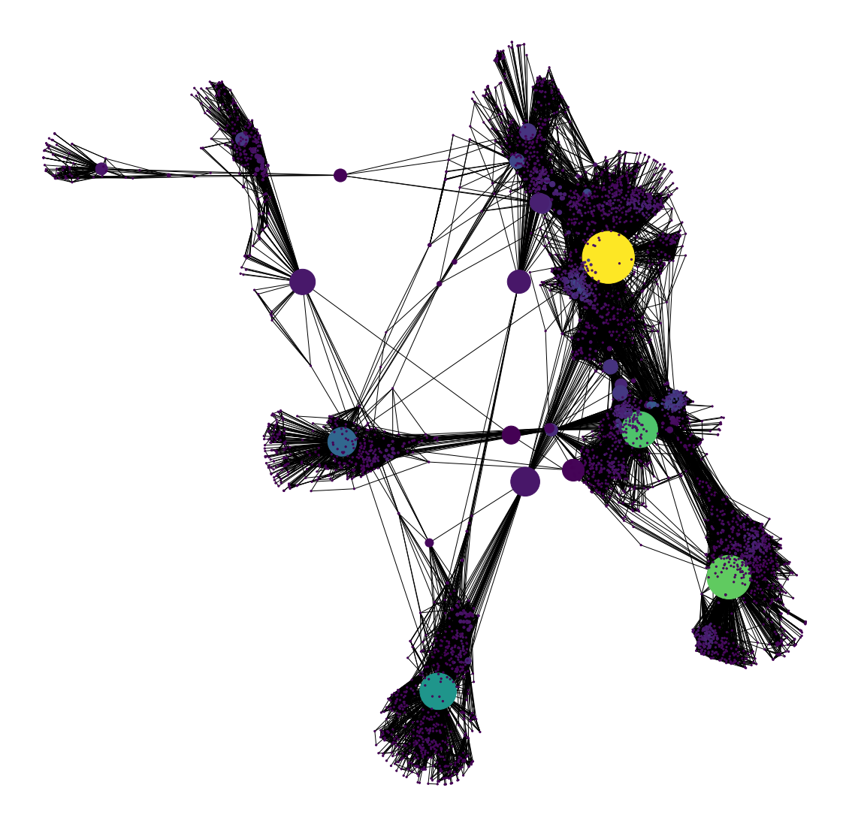
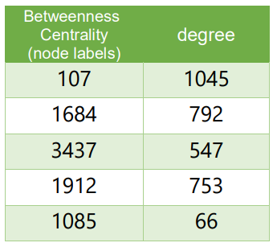
Betweenness Centrality

Slide 6
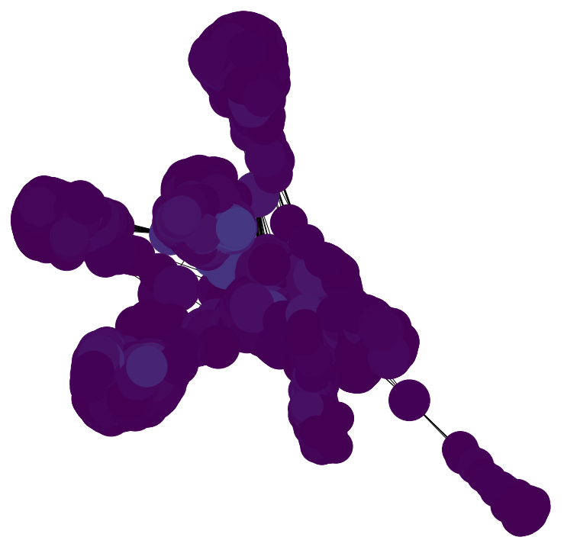

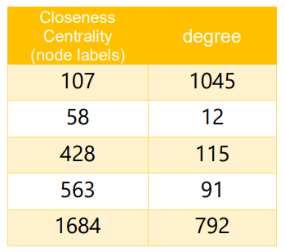
Closeness Centrality

Slide 7
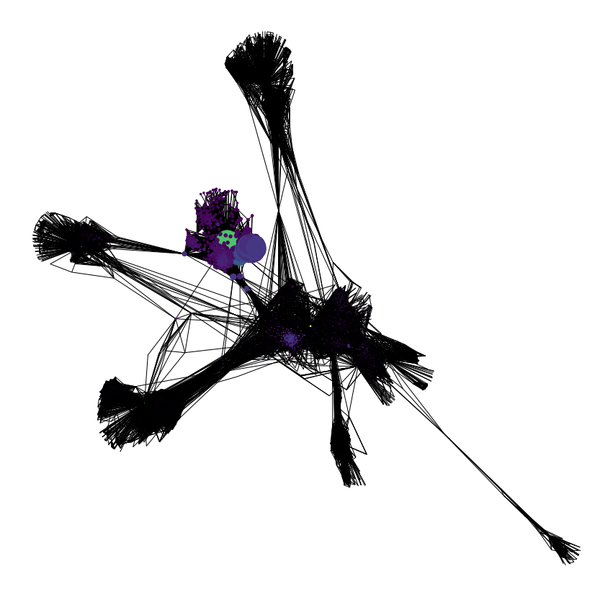
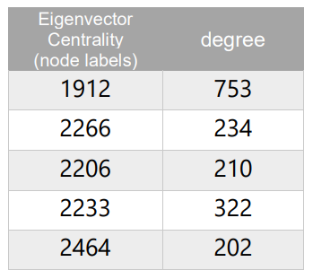
Eigenvector Centrality

Slide 8

Find the Shortest Path
sources = [20, 40, 65, 75]
targets = [650, 802, 920, 1010]

Slide 9
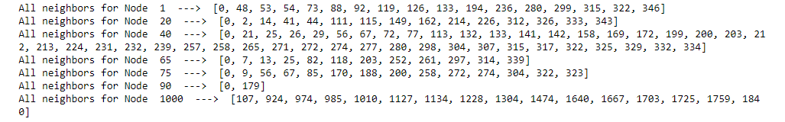
Find all the neighbors of the nodes
neigh = [1,20,40,65,75,90,1000,]

Slide 10
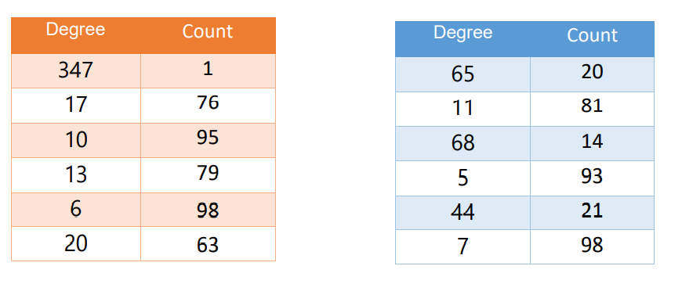
Count Degree Nodes

Slide 11
Thank You ☺

